Slide 1


India All-Star Training: Advance SQL
08.08.2022

Slide 2
Index
Day 1
Day 2
Handling Null Values
SQL Exists
SQL Aggregations and Group By
SQL WHERE vs HAVING
SQL Query clause order
Subqueries
Different JOINS
Join - Using WHERE or ON
SQL Self Joins
Working with Dates
Working with Strings
SQL Window Function
CTE - Common Table Expression
Order of operation in SQL
Query Formatting
SQL Performance tuning

Slide 3
Handling Null values
NULL is used in SQL to indicate that a value doesn’t exist in the database
While NULL indicates the absence of a value, the empty string and zero both represent actual values
Misunderstanding how NULL works in SQL can result in unexpected errors and output
We cannot use the comparison operators, =,<,>,<>, to test for NULL values
We have to use IS NULL and IS NOT NULL predicates for checking null values
id | employee | email1 | email2 | phone | salary
1 | Stan Marsh | NULL | smarsh@gmail.com | 740-097-0951 | 25,000
2 | Butters Stotch | bstotch@spelementary.com | bstotch@gmail.com | NULL | 25,000
3 | Kenny McCormick | NULL | NULL |  | 15,000
4 | Kyle Broflovski | kbroflovski@spelementary.com | kbroflovski@gmail.com | 619-722-2491
666 | Eric Cartman | ecartman@spelementary.com | ecartman@gmail.com | 740-6733-5671 | NULL
SELECT id, employee FROM tblSouthPark WHERE CAST(salary AS INT) < 20000;
SELECT id, employee FROM tblSouthPark WHERE CAST(salary AS INT) > 20000;
SELECT id, employee FROM tblSouthPark WHERE salary = NULL;
SELECT id, employee FROM tblSouthPark WHERE salary IS NULL;
SELECT id, employee, COALESCE(email1, email2, 'N/A') AS email FROM TblSouthPark;

Slide 4
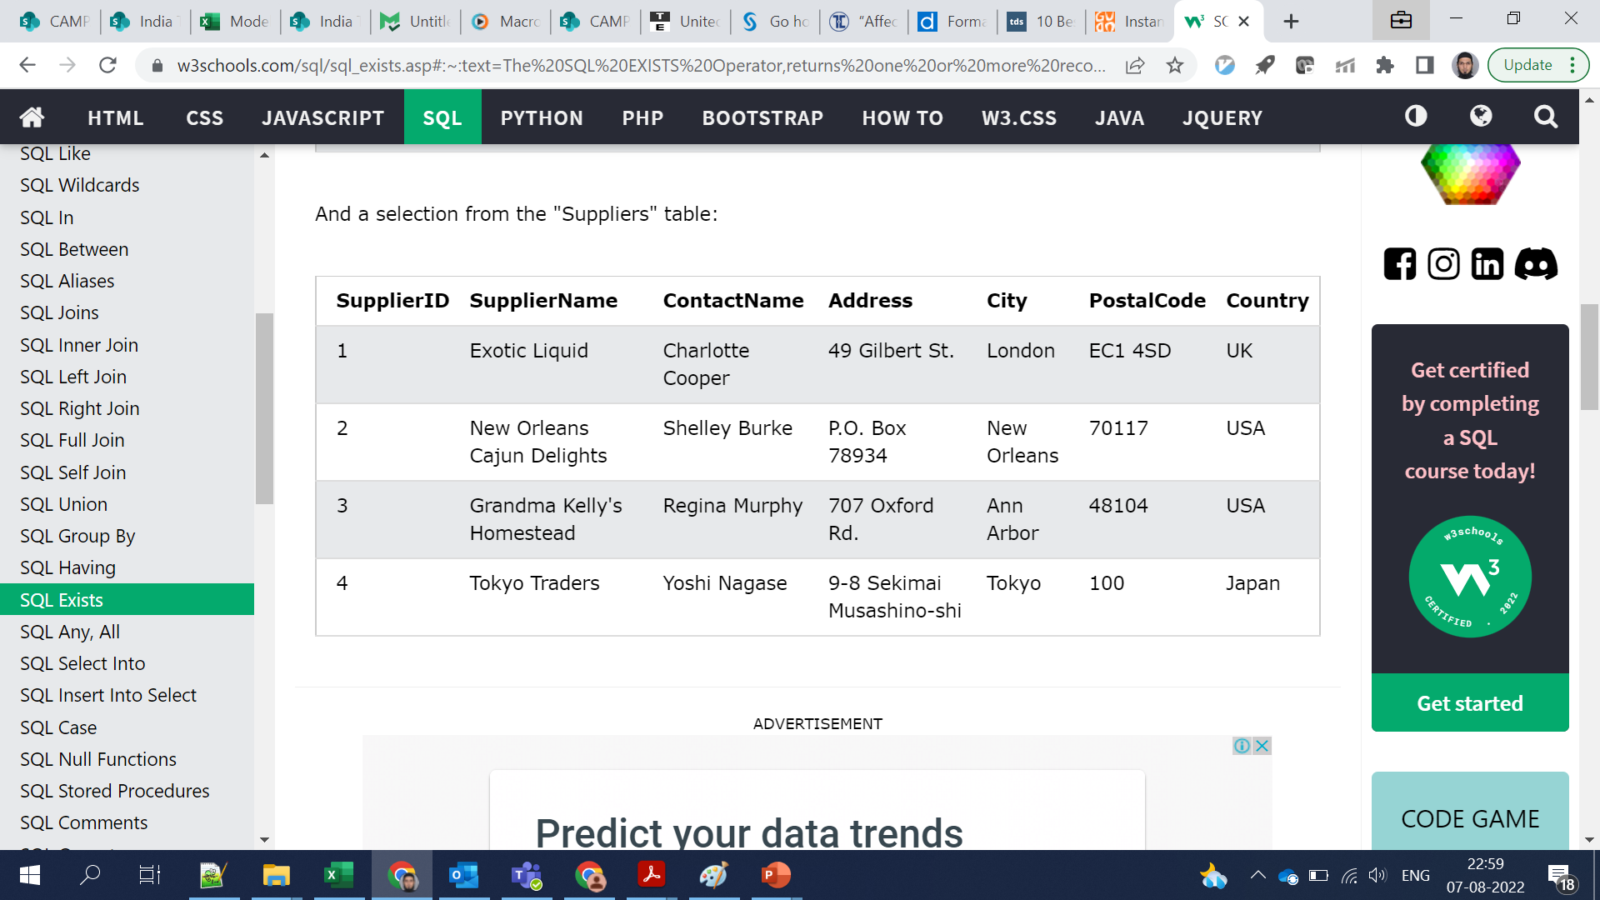
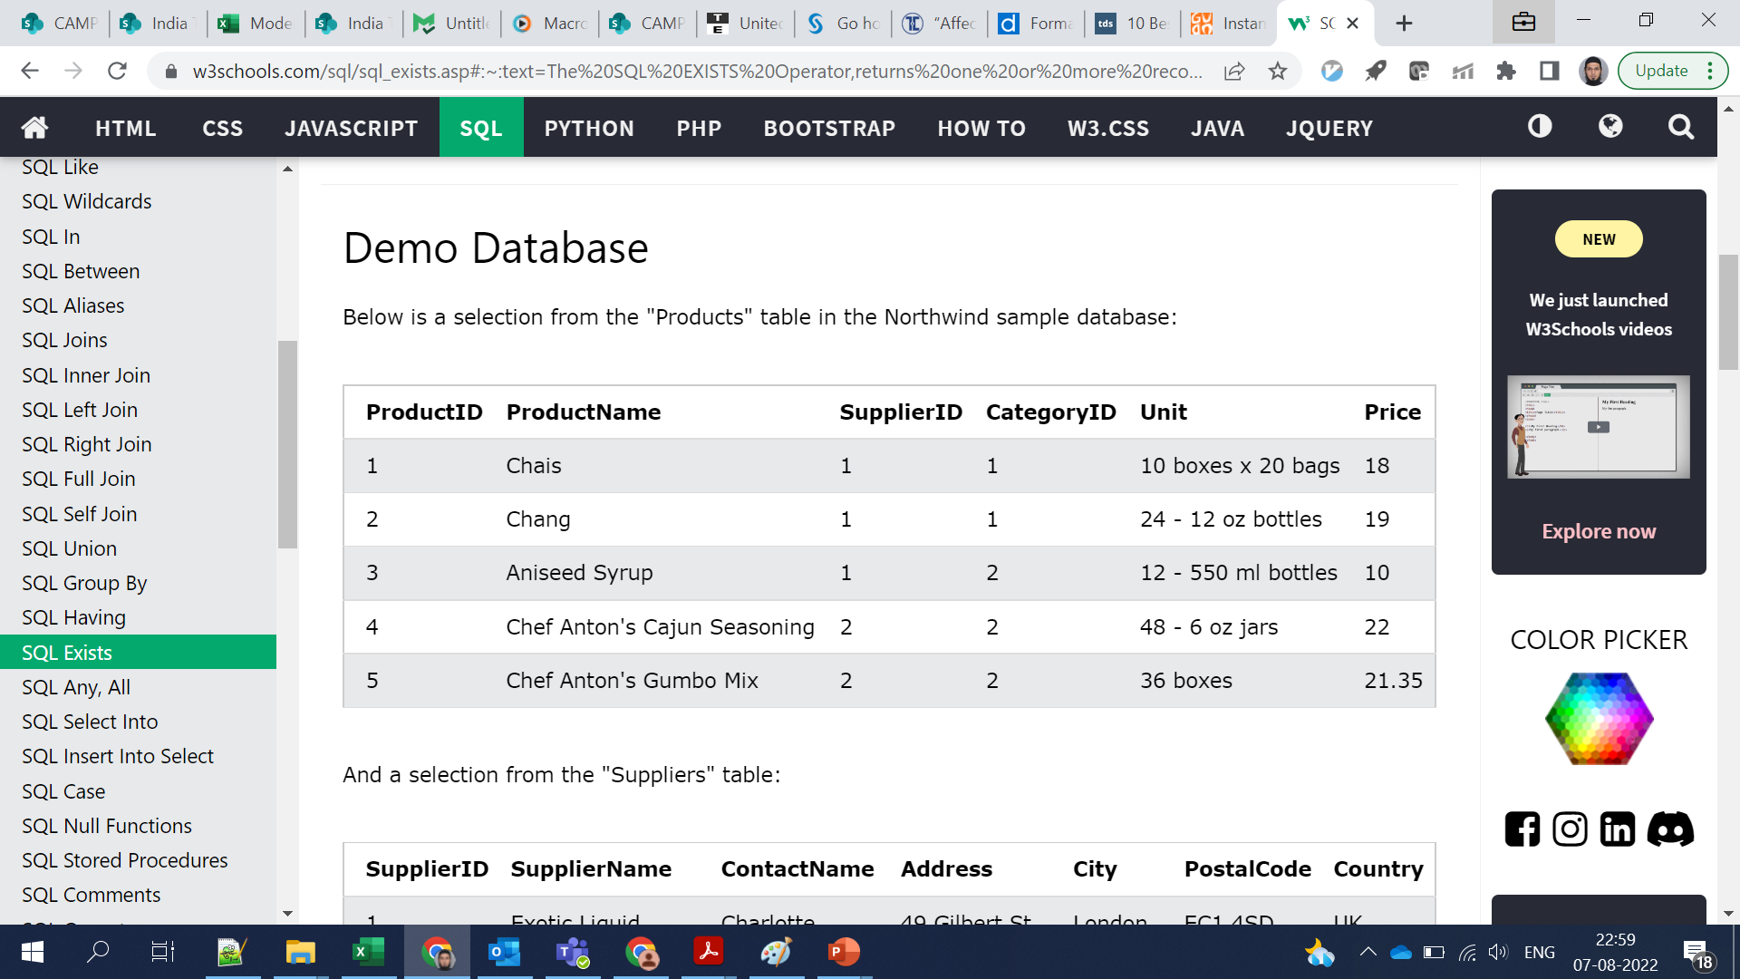
SQL EXISTS Operator
The EXISTS operator is used to test for the existence of any record in a subquery.
The EXISTS operator returns TRUE if the subquery returns one or more records.
lists the suppliers with a product price less than 20
SELECT column_name(s) FROM table_name WHERE EXISTS
(SELECT column_name
FROM table_name
WHERE condition);
SELECT SupplierName FROM Suppliers WHERE EXISTS
(SELECT ProductName
FROM Products
WHERE Products.SupplierID = Suppliers.supplierID
AND Price < 20);

Slide 5
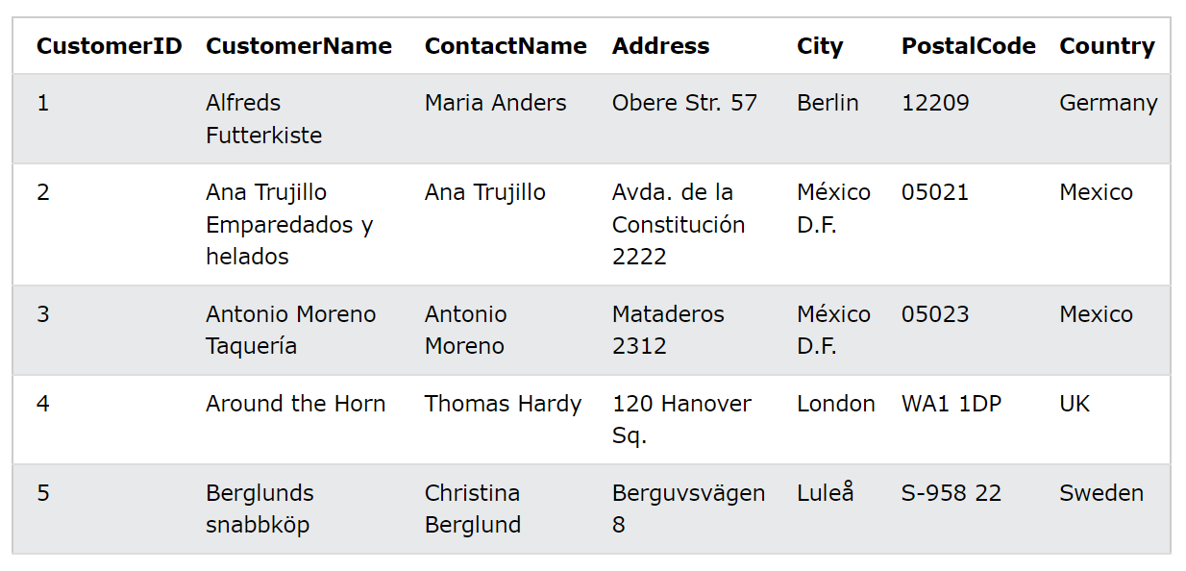
SQL Aggregations and Group by
SELECT COUNT(customerid) FROM Customers
SELECT country,
COUNT(customerid) FROM Customers GROUP BY country;
Types of aggregate functions:
Count()
Sum()
Avg()
Min()
Max()
What is the difference between COUNT(customerid), Count(1), count(*)
GROUP BY allows you to separate data into groups, which can be aggregated independently of one another

Slide 6
SQL WHERE vs HAVING
SELECT year, month, MAX(high) AS month_high
FROM Tutorial.Aapl_historical_stock_price
WHERE date > ‘2014-01-01’
GROUP BY year, month
HAVING MAX(high) > 400
ORDER BY year, month
HAVING is the "clean" way to filter a query that has been aggregated, but this is also commonly done using a subquery

Slide 7
SQL Query clause order
SELECT year, month, MAX(high) AS month_high
FROM Tutorial.Aapl_historical_stock_price
WHERE year = ‘2010'
GROUP BY year, month
HAVING MAX(high) > 400
ORDER BY year, month
So | SELECT
Few | FROM
Workers | WHERE
Go | GROUP BY
Home | HAVING
On Time | ORDER BY
SELECT companies.permalink AS companies_permalink,
acquisitions.company_permalink AS acquisitions_permalink,
acquisitions.acquired_at AS acquired_date
FROM Tutorial.Crunchbase_companies companies
LEFT JOIN Tutorial.Crunchbase_acquisitions acquisitions
ON companies.permalink = acquisitions.company_permalink
WHERE acquisitions.company_permalink != '/company/1000memories'
ORDER BY 1
So | SELECT
Few | FROM JOIN ON
Workers | WHERE
Go | GROUP BY
Home | HAVING
On Time | ORDER BY
The order in which we write the clauses is important
“So Few Workers Go Home on Time”

Slide 8
SUBQUERIES
SELECT LEFT(sub.date, 2) AS cleaned_month,
sub.day_of_week,
AVG(sub.incidents) AS average_incidents
FROM (
SELECT day_of_week,
date,
COUNT(incidnt_num) AS incidents
FROM tutorial.sf_crime_incidents_2014_01
GROUP BY 1,2
) sub
GROUP BY 1,2
ORDER BY 1,2
Subqueries (also known as inner queries or nested queries) are a tool for performing operations in multiple steps.
If we wanted to take the sums of several columns, then average all of those values, we would need to do each aggregation in a distinct step

Slide 9

SQL JOINS
SELECT Orders.orderid, Customers.customername FROM Orders INNER JOIN Customers
ON Orders.customerid=customers.customerid;

Slide 10
SQL JOINS – Continued
Select all with joins
SELECT * FROM Orders INNER JOIN Customers
ON Orders.customerid=Customers.customerid;
What happens when we do Select * in the join statement

Slide 11
SQL JOINS – Continued
Data Verification after each join
CREATE TABLE Order_Customer AS
SELECT Orders.orderid, Customers.customername FROM Orders
LEFT JOIN Customers
ON Orders.customerid=Customers.customerid;
SELECT COUNT(orderid) FROM Orders;--32000
SELECT COUNT(customerid) FROM Customers; --1800
SELECT COUNT(orderid), COUNT(customername) FROM Order_Customers;--?
Its always a best practice to check the number of rows affected, the result of join, the numbers of rows in the left table, number of rows on which join resulted

Slide 12
SQL Joins – Continued
Joins with Comparison Operators
SELECT c.permalink, c.name, c.status,
COUNT(i.investor_permalink) AS investors
FROM Tutorial.Crunchbase_companies c
LEFT JOIN Tutorial.Crunchbase_investments_part1 I
ON c.permalink = i.company_permalink
AND i.funded_year > c.founded_year + 5
GROUP BY 1,2, 3
Here's an example using > to join only investments that occurred more than 5 years after each company's founding year. This technique is especially useful for creating date ranges as shown above

Slide 13
Using WHERE or ON
SELECT c.permalink AS companies_permalink,
c.name AS companies_name, aq.company_permalink,
aq.acquired_at AS acquired_date
FROM tutorial.crunchbase_companies c
LEFT JOIN tutorial.crunchbase_acquisitions aq
ON c.permalink = aq.company_permalink
AND aq.company_permalink != '/company/1000memories’
ORDER BY 1
SELECT c.permalink AS companies_permalink,
c.name AS companies_name,
aq.company_permalink AS acquisitions_permalink,
aq.acquired_at AS acquired_date
FROM tutorial.crunchbase_companies c
LEFT JOIN tutorial.crunchbase_acquisitions aq
ON c.permalink = aq.company_permalink
WHERE aq.company_permalink != '/company/1000memories' OR aq.company_permalink IS NULL
ORDER BY 1
Normally, filtering is processed in the WHERE clause once the two tables have already been joined. It's possible, though that you might want to filter one or both tables before joining them. For example, you only want to create matches between the tables under certain circumstances
What's happening above is that the conditional statement AND... is evaluated before the join occurs. You can think of it as a WHERE clause that only applies to one of the tables. If you move the same filter to the WHERE clause, you will notice that the filter happens after the tables are joined

Slide 14
SQL Self Joins
SELECT DISTINCT japan_investments.company_name,
japan_investments.company_permalink
FROM Tutorial.Crunchbase_investments_part1 japan_investments
JOIN Tutorial.Crunchbase_investments_part1 gb_investments
ON japan_investments.company_name = gb_investments.company_name
AND gb_investments.investor_country_code = 'GBR’
AND gb_investments.funded_at > japan_investments.funded_at
WHERE japan_investments.investor_country_code = 'JPN' ORDER BY 1
Sometimes it can be useful to join a table to itself. Let’s say you wanted to identify companies that received an investment from Great Britain following an investment from Japan

Slide 15
Working with dates
Date comparison and understanding time zone before comparing dates from two different databases
Dates formatted as MM-DD-YYYY or YYYY-MM-DD
Exporting data to excel, a format that makes a lot of sense because it will sort in the same order whether it's stored as a date or as a string
Creating a calculated field from dates, like day of the week , weekend/weekday, etc. after an existing field. Or create a field that indicates how many days apart the values in two other date fields are
Date difference – Subtracting two dates and getting result in terms of number of days/months/etc
SELECT cleaned_date,
EXTRACT('year' FROM cleaned_date) AS year, EXTRACT('month' FROM cleaned_date) AS month, EXTRACT('day' FROM cleaned_date) AS day,
EXTRACT('hour' FROM cleaned_date) AS hour, EXTRACT('minute' FROM cleaned_date) AS minute, EXTRACT('second' FROM cleaned_date) AS second, EXTRACT('dow' FROM cleaned_date) AS day_of_week
FROM tutorial.sf_crime_incidents_cleandate

Slide 16
Working with strings
SELECT incidnt_num, date,
LEFT(date, 10) AS cleaned_date,
RIGHT(date, LENGTH(date) - 11) AS cleaned_time
FROM Tutorial.Sf_crime_incidents_2014_01
SELECT incidnt_num, date,
SUBSTR(date, 4, 2) AS day
COALESCE(descript, 'No Description')
FROM Tutorial.Sf_crime_incidents_2014_01
LEFT, RIGHT, and LENGTH – Extracting sub parts from string
TRIM – Removing and cleaning padding
SUBSTR – Extracting sub parts from middle of string
CONCAT – Joining two or more strings
Changing case with UPPER and LOWER – Important for string comparison
Turning strings into dates
Turning dates into more useful dates
COALESCE

Slide 17
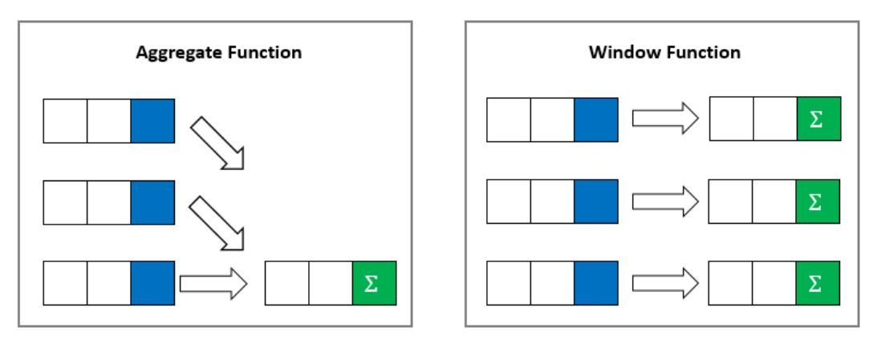
SQL Window function
The picture illustrates the main difference between aggregate functions and window functions

Slide 18
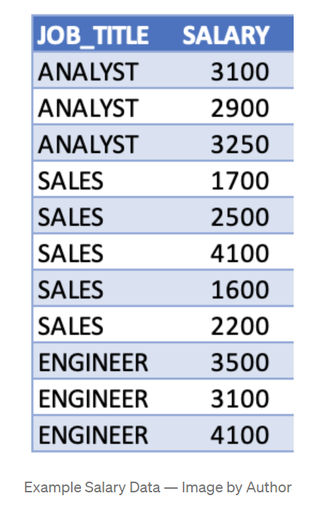
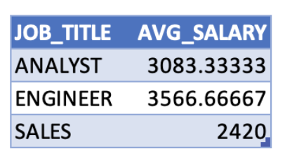
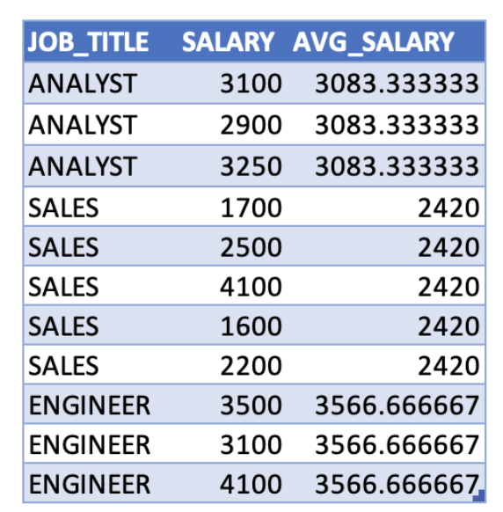
SQL Window function
Group by
SELECT job_title,
AVG(salary) AS avg_salary
FROM salary_info
Window Function
SELECT job_title, salary
AVG(salary)
OVER (PARTITION BY job_title) AS avg_salary
FROM salary_info
One major advantage of window functions is that it allows you to work with both aggregate and non-aggregate values all at once because the rows are not collapsed

Slide 19
SQL Window function
Aggregate window functions
AVG()
COUNT()
MAX()
MIN()
SUM()
SELECT start_terminal, duration_seconds,
SUM(duration_seconds) OVER
(PARTITION BY start_terminal) AS total,
SUM(duration_seconds) OVER
(PARTITION BY start_terminal ORDER BY start_time) AS total,
LAG(duration_seconds, 1) OVER
(PARTITION BY start_terminal ORDER BY duration_seconds) AS lag
NTILE(4) OVER
(PARTITION BY start_terminal ORDER BY duration_seconds) AS quartile,
FROM tutorial.dc_bikeshare_q1_2012
Value window functions
FIRST_VALUE()
LAST_VALUE()
LAG()
LEAD()
Ranking window functions
RANK()
DENSE_RANK()
NTILE()
ROW_NUMBER()

Slide 20
Window Function Frame Specification
Aggregate window functions
AVG()
COUNT()
MAX()
MIN()
SUM()
SELECT start_terminal, duration_seconds,
SUM(duration_seconds) OVER
(PARTITION BY start_terminal) AS total,
SUM(duration_seconds) OVER
(PARTITION BY start_terminal ORDER BY start_time
ROWS UNBOUNDED PRECEDING) AS total,
SUM(duration_seconds) OVER
(PARTITION BY start_terminal ORDER BY start_time
ROWS BETWEEN 1 PRECEDING AND 1 FOLLOWING) AS total,
FROM tutorial.dc_bikeshare_q1_2012
Value window functions
FIRST_VALUE()
LAST_VALUE()
LAG()
LEAD()
Ranking window functions
RANK()
DENSE_RANK()
NTILE()
ROW_NUMBER()

Slide 21
Common Window Function
Aggregate window functions
AVG()
COUNT()
MAX()
MIN()
SUM()
SELECT time,
subject,
val,
FIRST_VALUE(val) OVER w AS first,
LAST_VALUE(val) OVER w AS last,
NTH_VALUE(val, 2) OVER w AS second,
NTH_VALUE(val, 4) OVER w AS fourth
FROM observations
WINDOW w AS (PARTITION BY subject ORDER BY time ROWS UNBOUNDED PRECEDING);
Value window functions
FIRST_VALUE()
LAST_VALUE()
LAG()
LEAD()
Ranking window functions
RANK()
DENSE_RANK()
NTILE()
ROW_NUMBER()

Slide 22
Common Table Expression (CTE)
A CTE allows you to define and execute a query, of which the result exists temporarily and can be used within a larger query. CTEs are available on most modern databases.
It works like a derived table, with 2 advantages :
Using CTE improves the readability of your query
A CTE is defined once then can be referred multiple times
WITH my_cte AS ( SELECT col1, col2
FROM Table ) SELECT *
FROM my_cte

Slide 23
Common Table Expression (CTE)
SELECT customers.id, customers.name, customers.age, customers.gender, customers.salary, persona_salary.avg_salary AS persona_avg_salary, first_purchase.date FROM company.customers JOIN (SELE`CT customer_id, MIN(date) AS date FROM company.purchases GROUP BY customer_id) AS first_purchase ON first_purchase.customer_id = customers.id JOIN (SELECT age, gender, AVG(salary) AS avg_salary FROM company.customers GROUP BY age, gender) AS persona_salary ON persona_salary.age = customers.age AND persona_salary.gender = customers.gender WHERE customers.age <= 30
WITH first_purchase AS
(SELECT customer_id, MIN(date) AS date FROM company.purchases GROUP BY customer_id),
persona_salary AS
(SELECT age, gender, Avg(salary) AS avg_salary FROM company.customers GROUP BY age, gender) SELECT customers.id, customers.name, customers.age, customers.gender, customers.salary, persona_salary.avg_salary AS persona_avg_salary, first_purchase.date FROM company.customers JOIN first_purchase ON first_purchase.customer_id = customers.id JOIN persona_salary ON persona_salary.age = customers.age AND persona_salary.gender = customers.gender WHERE customers.age <= 30

Slide 24
Order of operations in SQL
From, Join
Where
Group By
Aggregate Functions
Having
Window Function
Select
Distinct
Union/Intersect/Except
Order by
Offset
Limit/Fetch/Top
It is important to note and remember the terms of the order of operations in SQL
This is important because based on this logical order, window functions are allowed in SELECT and ORDER BY, but they are not allowed in FROM, WHERE, GROUP BY, or HAVING clauses

Slide 25
Query Formatting
Use Uppercase for the Keywords
Use Snake Case for the schemas, tables, columns
Use aliases when it improves readability
Carefully use Indentation & White spaces
Avoid Select *
Go for the ANSI-92 JOIN Syntax
Use Common Table Expression (CTE)
Sometimes, it might be worth splitting into multiple queries
Meaningful names based on conventions
write useful comments
select customers.id,customers.name,count(transactions.id) from company.customers, company.transactions where customers.id = transactions.customer_id and customers.age <= 30 group by customers.id, customers.name
SELECT customers.id, customers.name, COUNT(transactions.id) AS nb_transaction FROM company.customers JOIN company.transactions ON customers.id = transactions.customer_id WHERE customers.age <= 30 GROUP BY customers.id, customers.name

Slide 26
SQL Performance Tuning
SQL Performance is dependent on:
Table size: If the query hits one or more tables with millions of rows or more, it could affect performance
Joins: If the query joins two tables in a way that substantially increases the row count, the query is likely to be slow
Aggregations: Combining multiple rows to produce a result requires more computation than simply retrieving rows
Best Practices to improve query performance
Reducing table size: Filtering the data to include only the observations you need can dramatically improve query speed
Making joins less complicated: We would notice considerable improvement by aggregating before joining
Create joins with INNER JOIN (not WHERE): Cartesian Join creates all possible combinations and then filters the rows
Making joins faster: Avoid joins on Char fields and avoid using like, ilike in joins
EXPLAIN at the beginning of any working query to get a sense of how long it will take
Select Sparingly: SELECT fields instead of using SELECT *
Avoid SELECT DISTINCT instead you GROUP BY
Use WHERE instead of HAVING to define filters: HAVING should only be used when filtering on an aggregated field
Avoid Correlated SQL Subqueries: the inner query is run for each row returned by the outer query
Avoid Wildcard String Searches: Wildcard searches are costly operations, prefer wildcard at the end if unavoidable
Use of Table/View, Indexes, Partitions
Notes:
Correlated SQL Subqueries
SELECT c.Name, c.City, (SELECT CompanyName FROM Company WHERE ID = c.CompanyID) AS CompanyName FROM Customer c

Slide 27
Assignment – 1
Data Analysis on tutorial.crunchbase tables on mode.com
For different category of acquirers, what is the average number of months since the inception of the acquired company after which they are acquired
Is there any trend for quarters when more companies are acquired
For each company_category_code identify the average raised_amount_usd per quarter
Which investor (company ) is more likely to invest in USA based companies?
For different type of funding rounds, what is the average raised amount per quarter
Identify companies that received an investment from Japan following an investment from Great Britain where investor is finance category company
Out of all 'operating' status companies, which category of companies have the highest average funding_total_usd?
For each category, what percent of companies received funding within 3 years of their founding?
Clean the 'last_funding_at' column (convert it to time stamp) and get the time difference with the current time.
Provide additional analysis based on the data in crunchbase tables
Submission format: Word document with question, query and screenshot of mode query execution

Slide 28
Assignment – 2
DataMart Creation on tutorial.flights on mode.com
The output should contain all the attributes as different columns in the datamart created
Create a DataMart at airline level with different features like
Total Number of flights
Total Number of delayed flights (Based on arrival delay)
Percentage of delayed flights
Total Number of cancelled flights (All reasons)
Percentage of cancelled flights
Give Rank number to each airline based on percentage of delayed flights
Give Rank number to each airline based on number of destinations it covers
Add additional features which can help understand airlines better based on their performance
Submission format: Word document with question, query and screenshot of mode query execution

Slide 29
Thank You

